Slide 1
Laplace Domain
Control Engineering

Slide 2
Course Schedule
Systems
Continuous-time Controllers
Laplace Domain
Poles/Zeros & Stability
Controller Design
Discrete-time Controllers
State Space Representation
Advanced Control Methods

Slide 3
Laplace Domain
Laplace transform
Transfer function
Frequency response
Bode plots
Bandwidth

Slide 4
Why the Laplace Transform?
Converts differential equations (dynamic systems) into algebraic equations → easier to solve
Simplifies analysis and design
Natural language of control theory

Slide 5
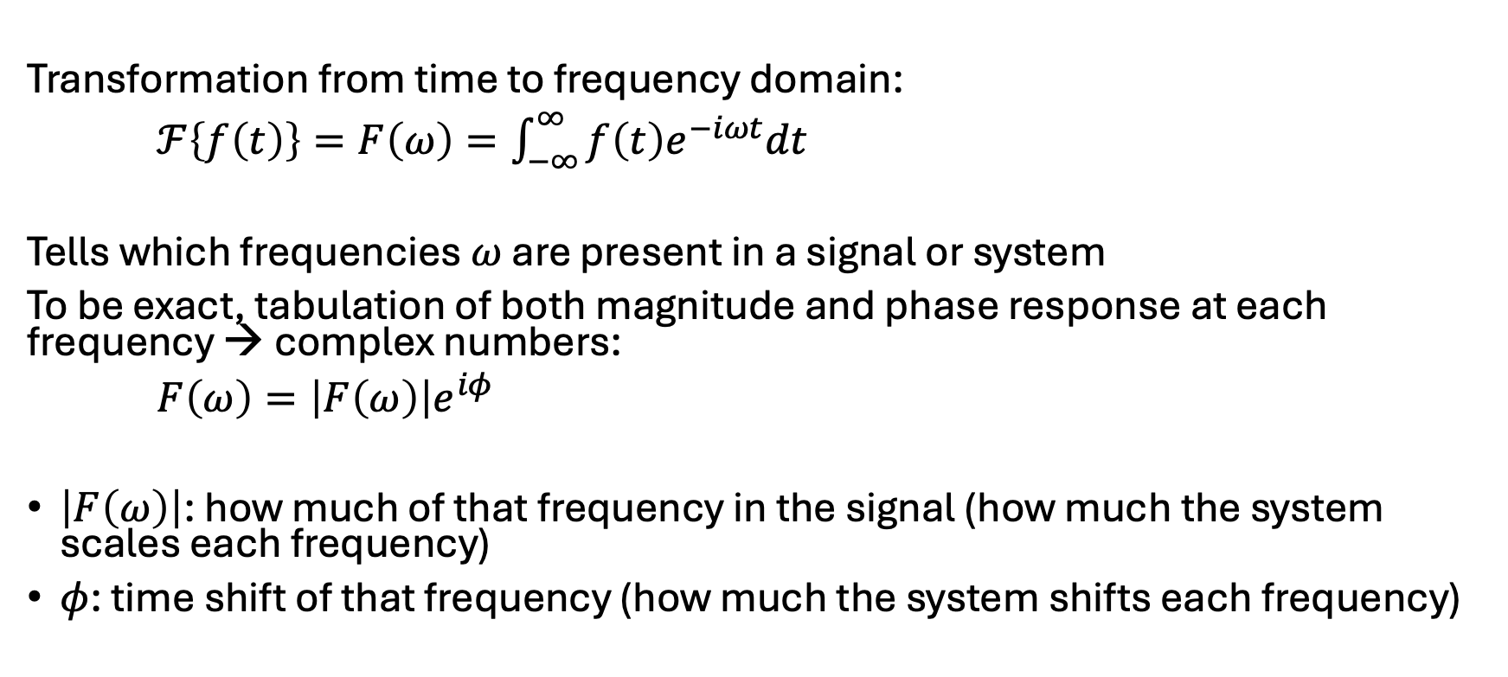
Reminder: Fourier Transform
Transformation from time to frequency domain:
$ℱ\left\{f\left(t\right)\right\}=F\left(ω\right)=\int_{−∞}^{∞}{f\left(t\right)e^{−iωt}dt}$
Tells which frequencies $ω$ are present in a signal or system
To be exact, tabulation of both magnitude and phase response at each frequency → complex numbers:
$F\left(ω\right)=\left|F\left(ω\right)\right|e^{iφ}$
$\left|F\left(ω\right)\right|$: how much of that frequency in the signal (how much the system scales each frequency)
$φ$: time shift of that frequency (how much the system shifts each frequency)

Slide 6
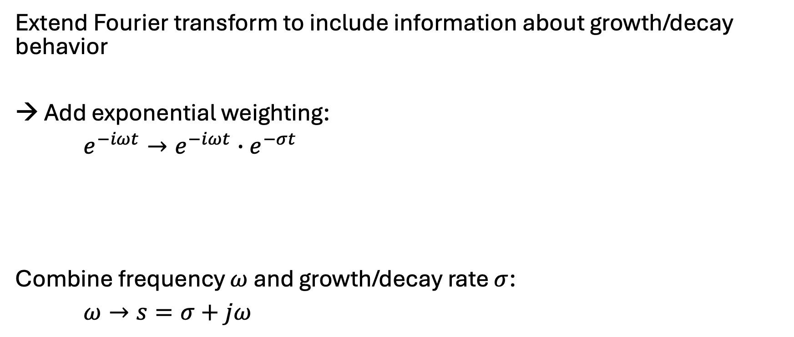
Idea of Laplace Transform
Extend Fourier transform to include information about growth/decay behavior
→ Add exponential weighting:
$e^{−iωt}→e^{−iωt}∙e^{−σt}$
Combine frequency $ω$ and growth/decay rate $σ$:
$ω→s=σ+jω$
oscillation
growth/decay

Slide 7
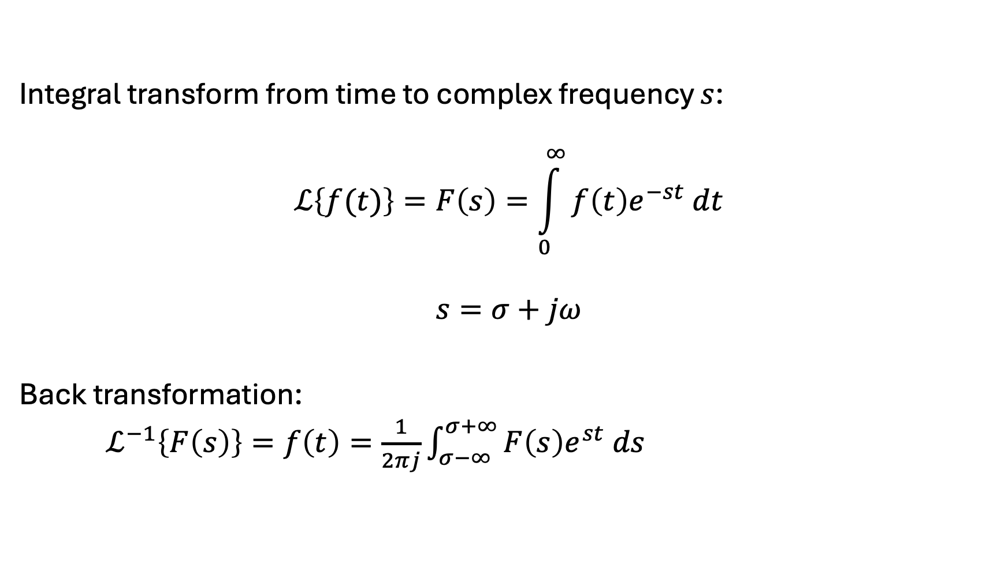
Definition of Laplace Transform
Integral transform from time to complex frequency $s$:
$$ℒ\left\{f(t)\right\}=F\left(s\right)=\int_{0}^{∞}{f\left(t\right)e^{−st} dt}$$
$$s=σ+jω$$
Back transformation:
$ℒ^{−1}\left\{F\left(s\right)\right\}=f\left(t\right)=\frac{1}{2πj}\int_{σ−∞}^{σ+∞}{F\left(s\right)e^{st} ds}$

Slide 8
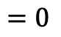
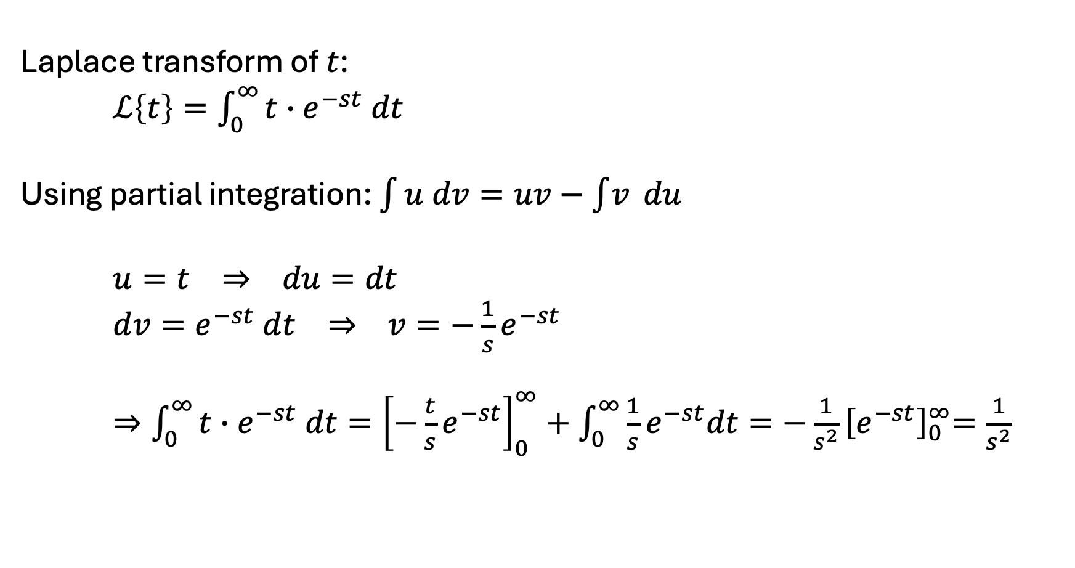
Example
Laplace transform of $t$:
$ℒ\left\{t\right\}=\int_{0}^{∞}{t∙e^{−st} dt}$
Using partial integration: $\int{u dv=uv−\int{v} du}$
$u=t ⇒ du=dt$
$dv=e^{−st} dt ⇒ v={−\frac{1}{s}e}^{−st}$
$⇒\int_{0}^{∞}{t∙e^{−st} dt}={\left[−{\frac{t}{s}e}^{−st}\right]}_{0}^{∞}+\int_{0}^{∞}{{\frac{1}{s}e}^{−st}dt}={−\frac{1}{s^{2}}\left[e^{−st}\right]}_{0}^{∞}=\frac{1}{s^{2}}$
$$=0$$

Slide 9
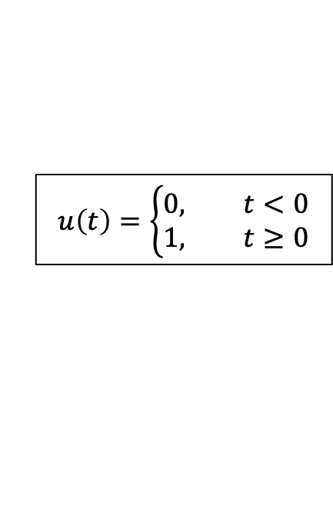
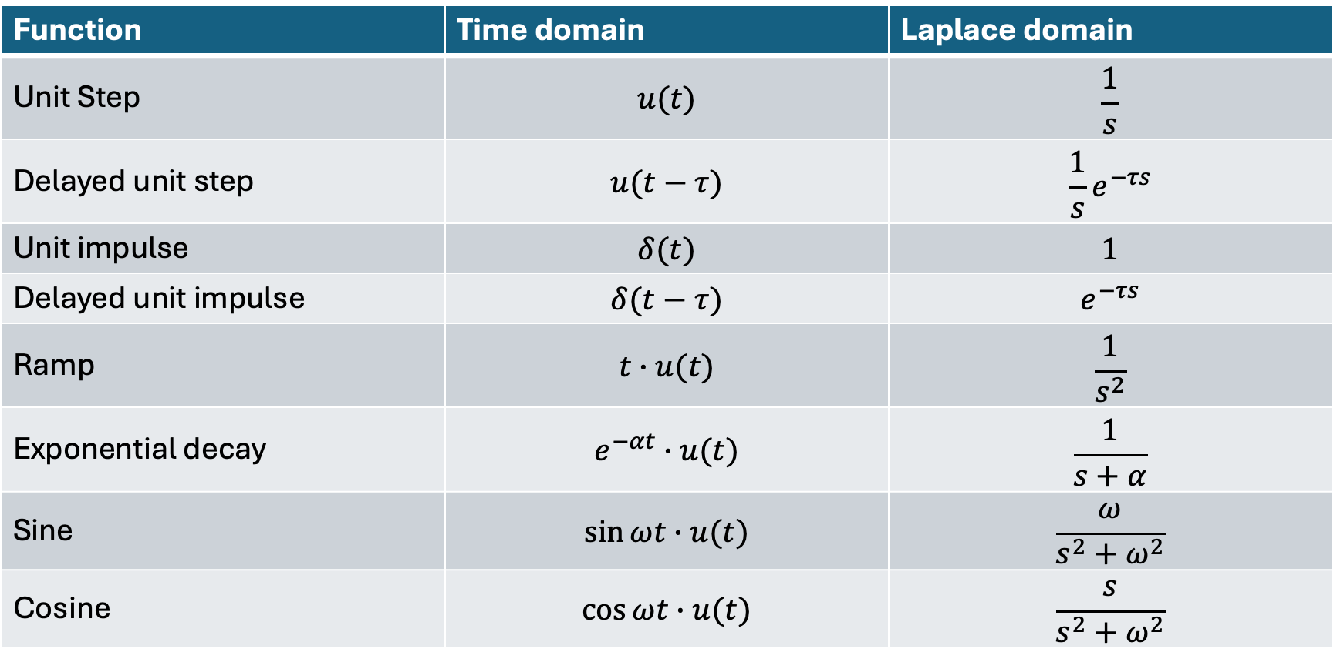
Laplace of Common Signals
$$u\left(t\right)=\left\{\begin{aligned}0, t<0 \\ 1, t≥0\end{aligned}\right.$$
Function | Time domain | Laplace domain
Unit Step | $$u(t)$$ | $$\frac{1}{s}$$
Delayed unit step | $$u(t−τ)$$ | $$\frac{1}{s}e^{−τs}$$
Unit impulse | $$δ(t)$$ | $$1$$
Delayed unit impulse | $$δ(t−τ)$$ | $$e^{−τs}$$
Ramp | $$t∙u(t)$$ | $$\frac{1}{s^{2}}$$
Exponential decay | $$e^{−αt}∙u(t)$$ | $$\frac{1}{s+α}$$
Sine | $$\sin{ωt}∙u(t)$$ | $$\frac{ω}{s^{2}+ω^{2}}$$
Cosine | $$\cos{ωt}∙u(t)$$ | $$\frac{s}{s^{2}+ω^{2}}$$

Slide 10
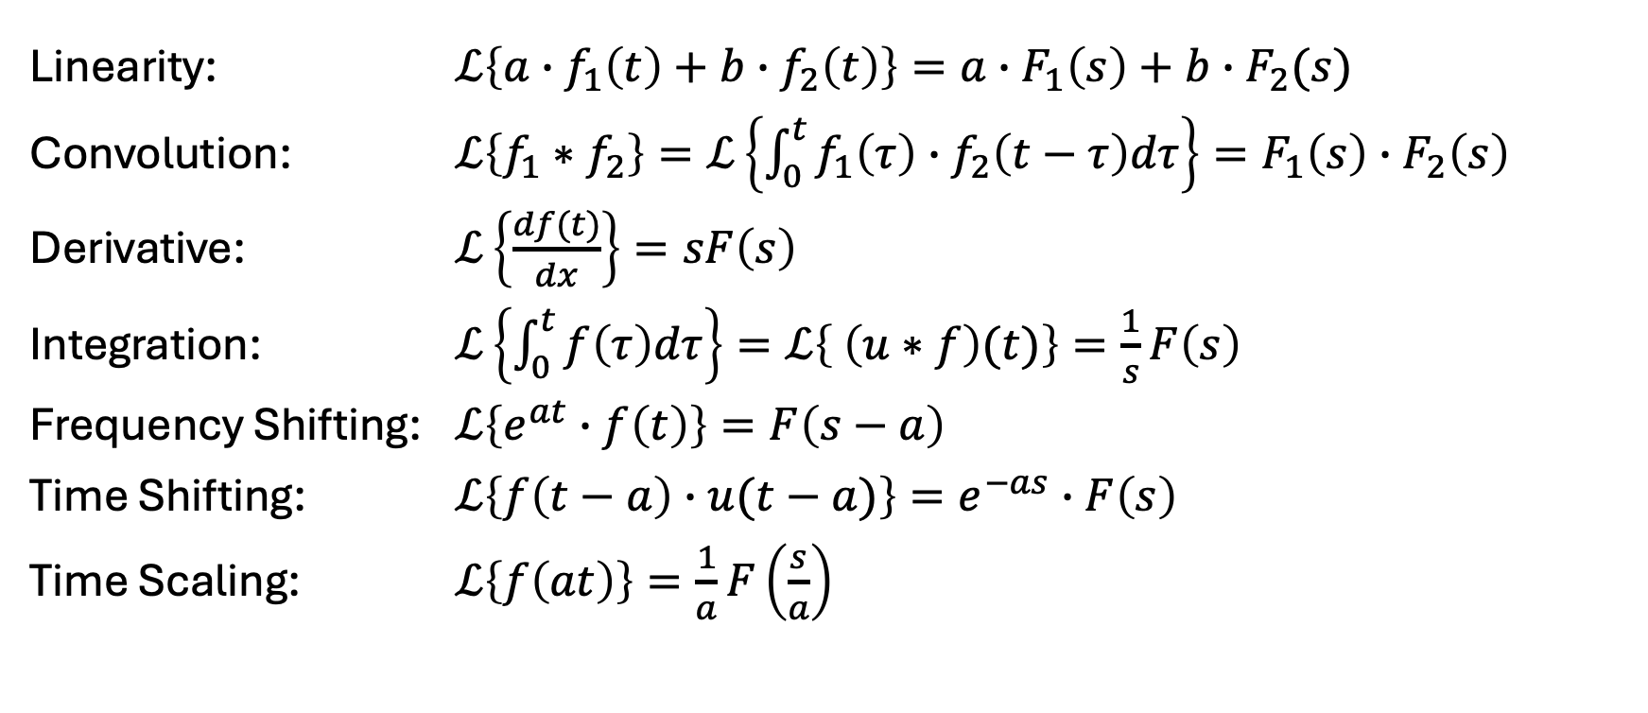
Properties of Laplace Transform
Linearity: $ℒ\left\{a∙f_{1}\left(t\right)+b∙f_{2}\left(t\right)\right\}=a∙F_{1}\left(s\right)+b∙F_{2}(s)$
Convolution: $ℒ\left\{f_{1}∗f_{2}\right\}=ℒ\left\{\int_{0}^{t}{f_{1}\left(τ\right)∙f_{2}\left(t−τ\right)dτ}\right\}=F_{1}\left(s\right)∙F_{2}\left(s\right)$
Derivative: $ℒ\left\{\frac{df(t)}{dx}\right\}=sF\left(s\right)$
Integration: $ℒ\left\{\int_{0}^{t}{f\left(τ\right)dτ}\right\}=ℒ\left\{ \left(u∗f\right)(t)\right\}=\frac{1}{s}F\left(s\right)$
Frequency Shifting: $ℒ\left\{e^{at}∙f\left(t\right)\right\}=F\left(s−a\right)$
Time Shifting: $ℒ\left\{f\left(t−a\right)∙u(t−a)\right\}=e^{−as}∙F\left(s\right)$
Time Scaling: $ℒ\left\{f\left(at\right)\right\}=\frac{1}{a}F\left(\frac{s}{a}\right)$

Slide 11
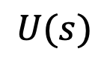
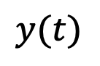


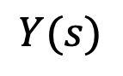
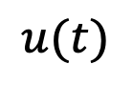
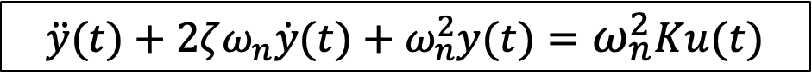
From Differential Equation to Transfer Function
Example: PT2 system
Time domain:
Frequency domain:
Transfer function: $G\left(s\right)=\frac{Y(s)}{U(s) }=\frac{ω_{n}^{2}K}{s^{2}+2ζω_{n}s+ω_{n}^{2}}$ (assuming zero initial conditions)
$$u(t)$$
$$\ddot{y}(t)+2ζω_{n}\dot{y}(t)+ω_{n}^{2}y(t)=ω_{n}^{2}Ku(t)$$
$$y(t)$$
$$U(s)$$
$$s^{2}Y(s)+2ζω_{n}sY(s)+ω_{n}^{2}Y(s)=ω_{n}^{2}KU(s)$$
$$Y(s)$$

Slide 12
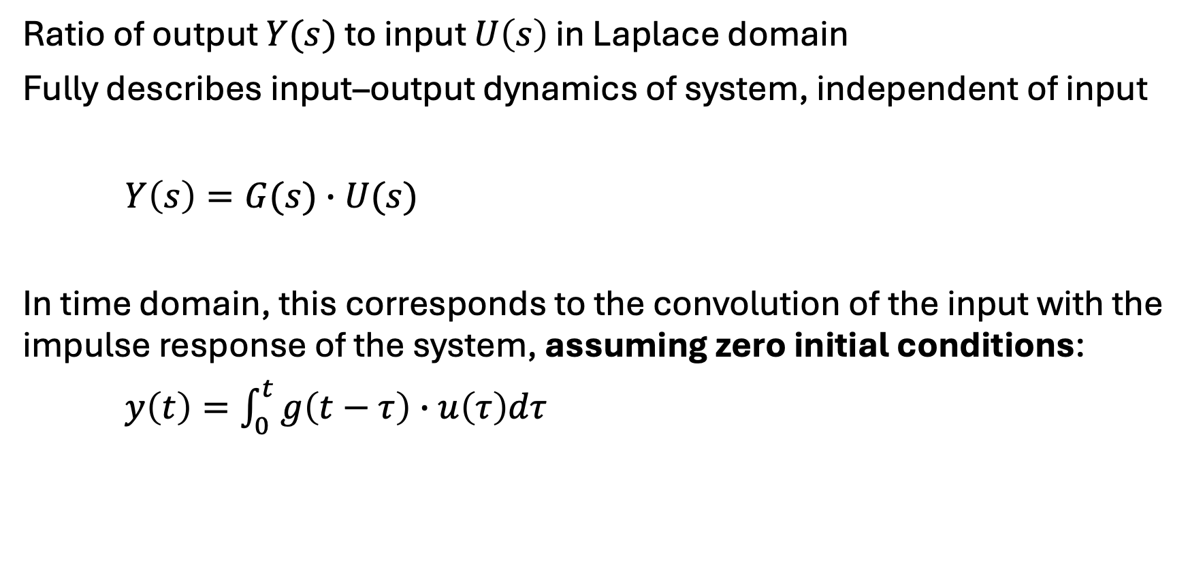
Transfer Function
Ratio of output $Y(s)$ to input $U\left(s\right)$ in Laplace domain
Fully describes input–output dynamics of system, independent of input
$Y\left(s\right)=G(s)∙U(s)$
In time domain, this corresponds to the convolution of the input with the impulse response of the system, assuming zero initial conditions:
$y\left(t\right)=\int_{0}^{t}{g\left(t−τ\right)∙u\left(τ\right)dτ}$

Slide 13
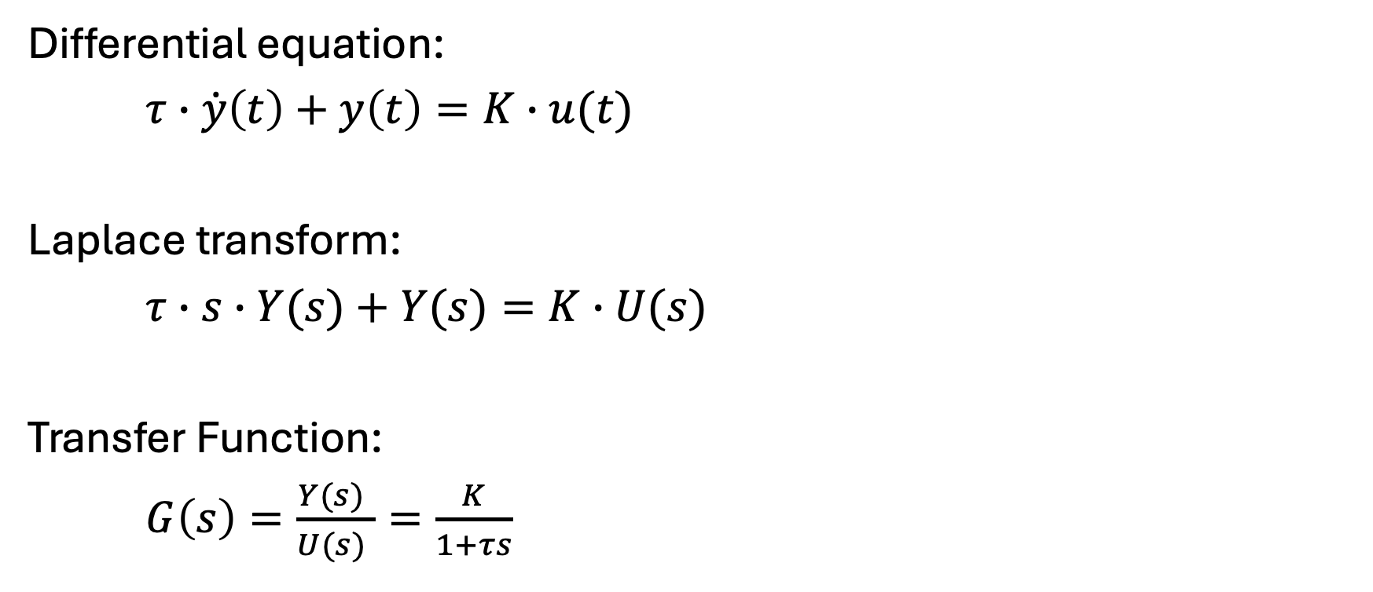
Transfer Function for PT1 System
Differential equation:
$τ∙\dot{y}\left(t\right)+y\left(t\right)=K∙u(t)$
Laplace transform:
$τ∙s∙Y(s)+Y(s)=K∙U(s)$
Transfer Function:
$G\left(s\right)=\frac{Y(s) }{U(s) }=\frac{K}{1+τs}$
independent of input

Slide 14

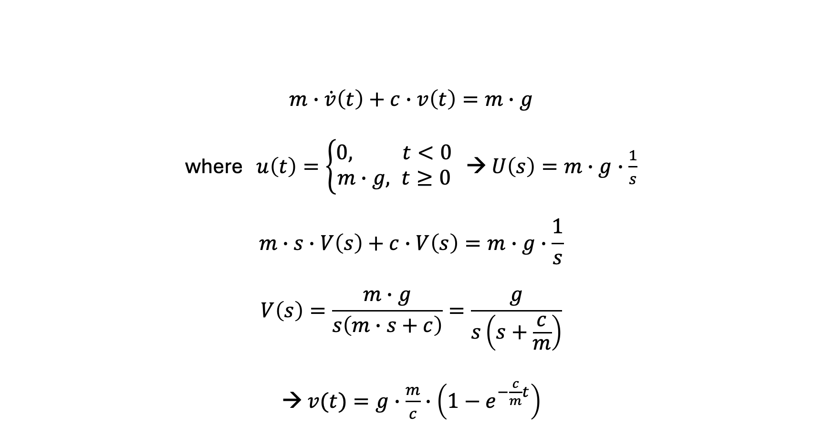
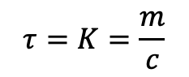
Example: Free Fall with Viscous Damping
$$m∙\dot{v}\left(t\right)+c∙v\left(t\right)=m∙g$$
where $u\left(t\right)=\left\{\begin{aligned}0, t<0 \\ m∙g, t≥0\end{aligned}\right.$ → $U\left(s\right)=m∙g∙\frac{1}{s}$
$$m∙s∙V\left(s\right)+c∙V\left(s\right)=m∙g∙\frac{1}{s}$$
$$V\left(s\right)=\frac{m∙g}{s\left(m∙s+c\right)}=\frac{g}{s\left(s+\frac{c}{m}\right)}$$
→ $v(t)=g∙\frac{m}{c}∙\left(1−e^{−\frac{c}{m}t}\right)$
Transformation table:
$$\frac{α}{s\left(s+α\right)}↦1−e^{−αt}$$
$$τ=K=\frac{m}{c}$$

Slide 15
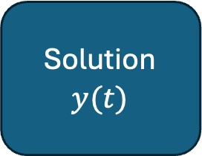
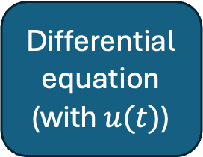
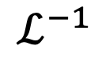
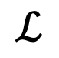
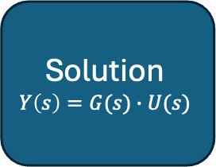
System Response with Transfer Function
Differential equation
(with $u(t)\text{)}$
Solution
$$y(t)$$
$$ℒ$$
$$ℒ^{−1}$$
most elaborate part
Algebraic equation
Solution
$$Y\left(s\right)=G(s)∙U(s)$$

Slide 16
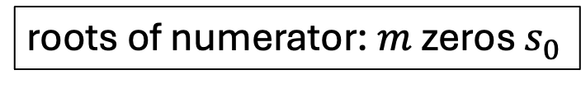

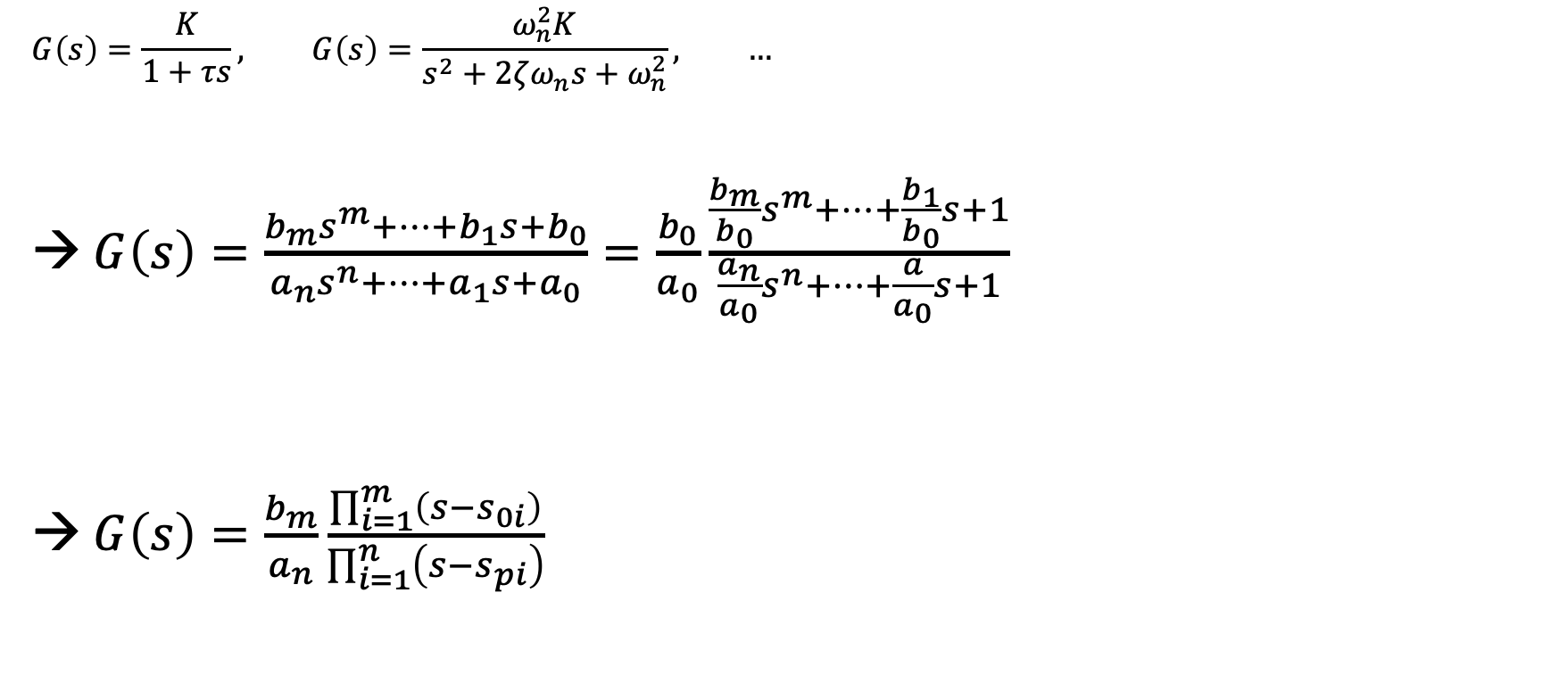

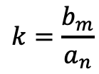
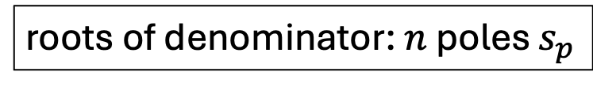
Transfer Function in Polynomial Form
$$G\left(s\right)=\frac{K}{1+τs}, G\left(s\right)=\frac{ω_{n}^{2}K}{s^{2}+2ζω_{n}s+ω_{n}^{2}}, …$$
→ $G\left(s\right)=\frac{b_{m}s^{m}+⋯+b_{1}s+b_{0}}{a_{n}s^{n}+⋯+a_{1}s+a_{0}}=\frac{b_{0}}{a_{0}}\frac{\frac{b_{m}}{b_{0}}s^{m}+⋯+\frac{b_{1}}{b_{0}}s+1}{\frac{a_{n}}{a_{0}}s^{n}+⋯+\frac{a}{a_{0}}s+1}$
→ $G\left(s\right)=\frac{b_{m}}{a_{n}}\frac{\prod_{i=1}^{m}{\left(s−s_{0i}\right)}}{\prod_{i=1}^{n}{\left(s−s_{pi}\right)}}$
Input coupling:
describes how the input enters the system (can contain time derivatives)
fundamental theorem of algebra
Intrinsic system dynamics:
characteristic polynomial of the system
$$K=\frac{b_{0}}{a_{0}}$$
roots of numerator: $m$ zeros $s_{0}$
roots of denominator: $n$ poles $s_{p}$
$$k=\frac{b_{m}}{a_{n}}$$
Causality requires $n≥m$ (output cannot depend on derivative of input)

Slide 17
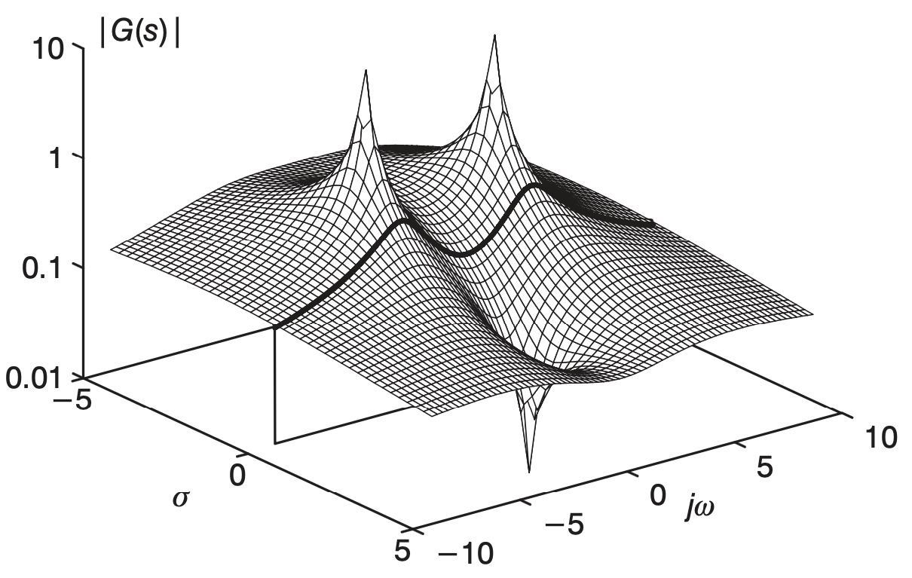
Graphical Interpretation of Transfer Function
conjugate pair
Contains (complex) poles and zeros

Slide 18

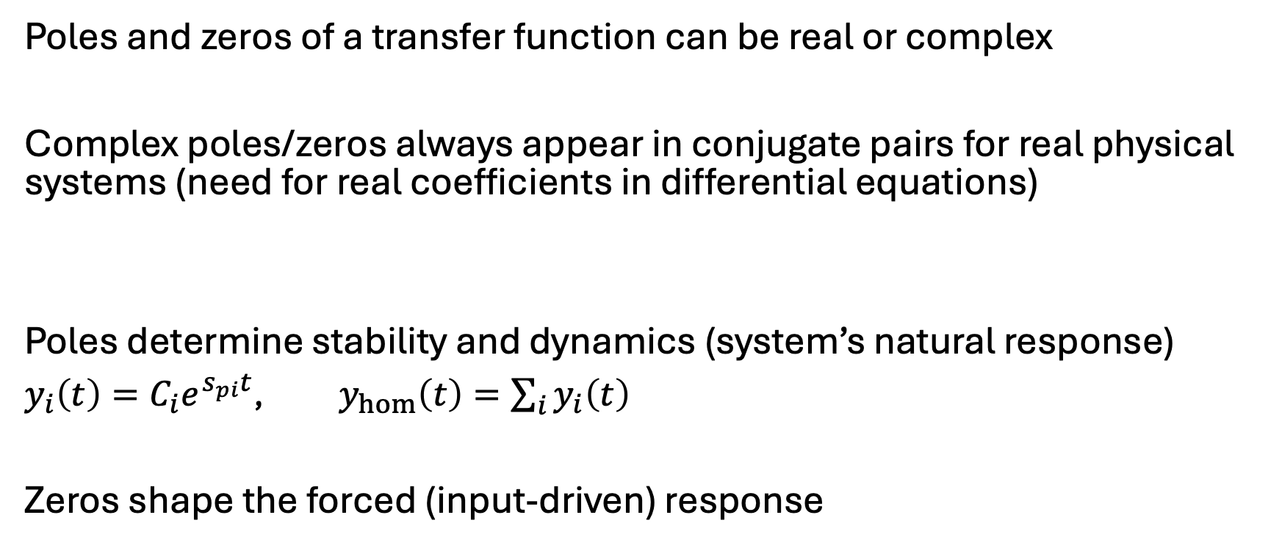
Poles and Zeros
Poles and zeros of a transfer function can be real or complex
Complex poles/zeros always appear in conjugate pairs for real physical systems (need for real coefficients in differential equations)
Poles determine stability and dynamics (system’s natural response)
$y_{i}\left(t\right)=C_{i}e^{s_{pi}t}$, $y_{hom}\left(t\right)=\sum_{i}{y_{i}\left(t\right)}$
Zeros shape the forced (input-driven) response
$$\left(s−\left(σ+jω\right)\right)\left(s−\left(σ−jω\right)\right)={\left(s−σ\right)}^{2}+ω^{2}$$
More about this later …

Slide 19
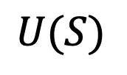
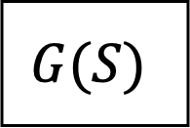
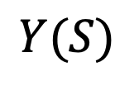
Block Diagrams
$$U(S)$$
$$G(S)$$
$$Y(S)$$
Modular representation

Slide 20
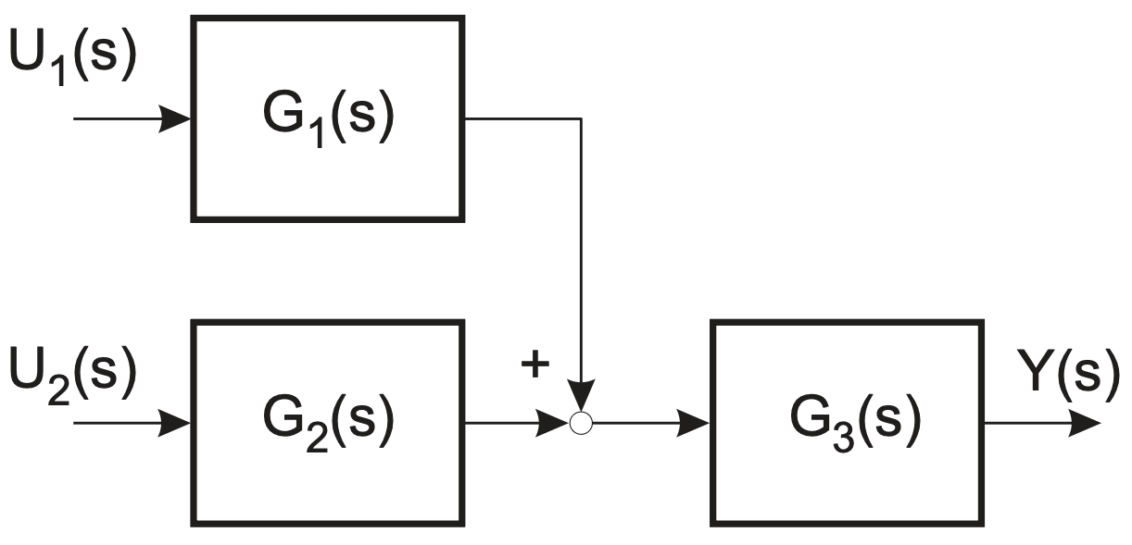
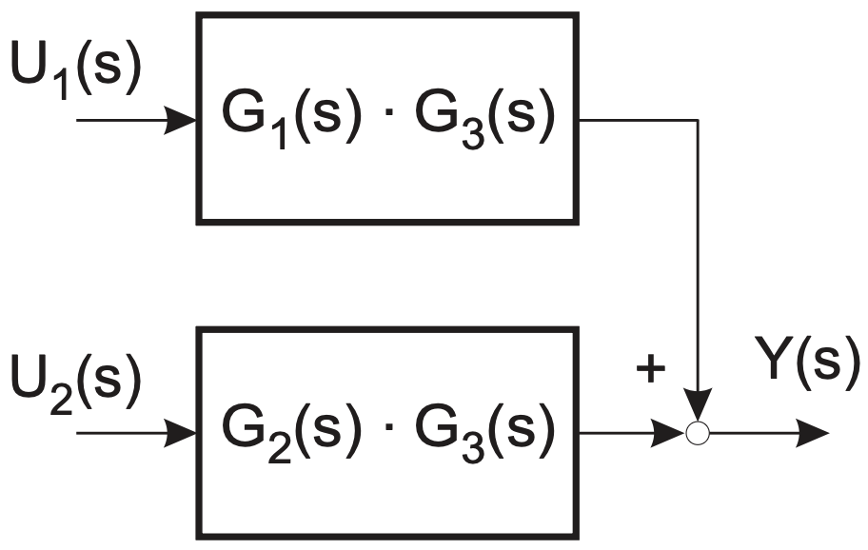
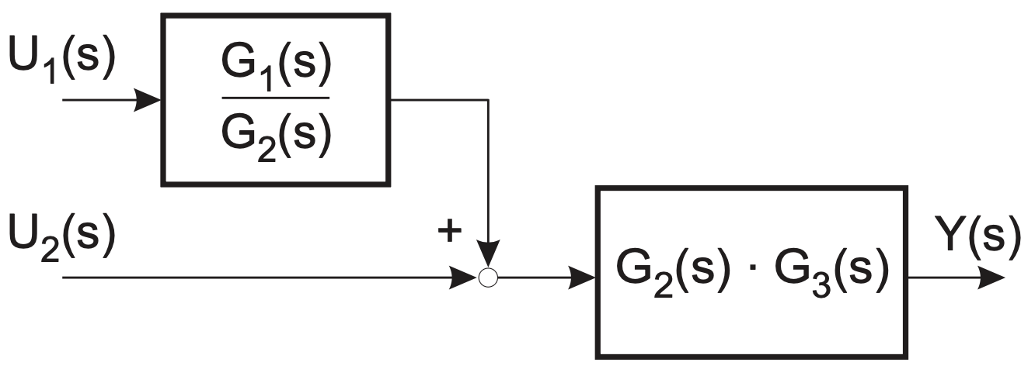
Block Diagram Algebra

Slide 21
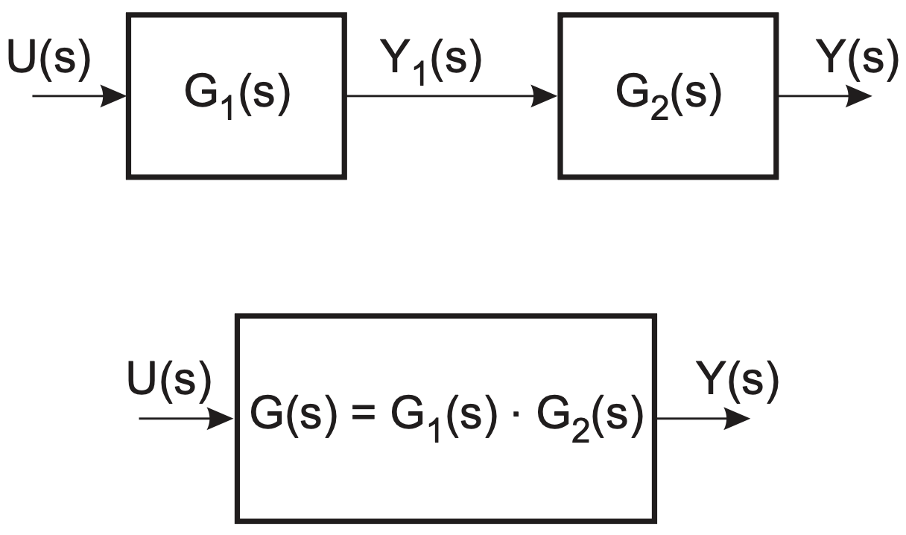
Series Connection

Slide 22
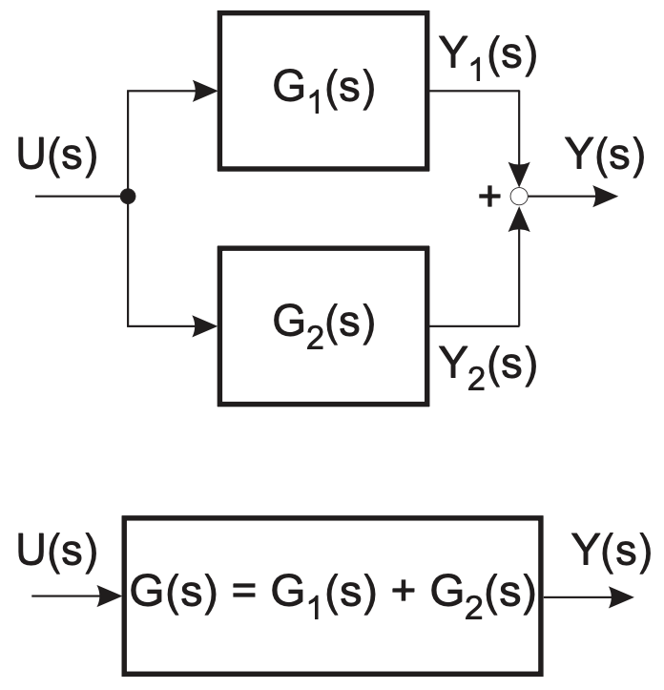
Parallel Connection

Slide 23
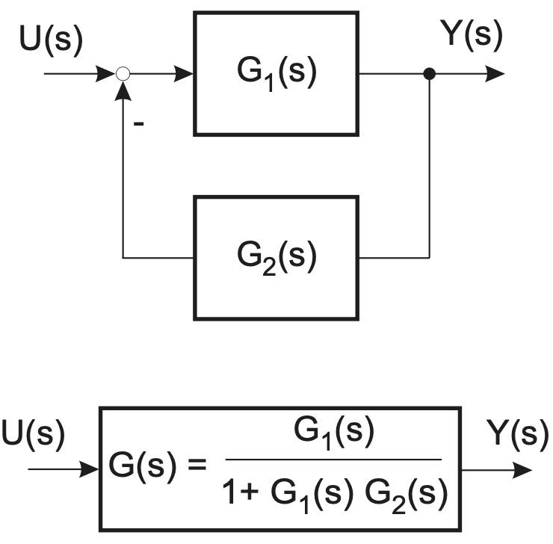
Feedback Connection

Slide 24
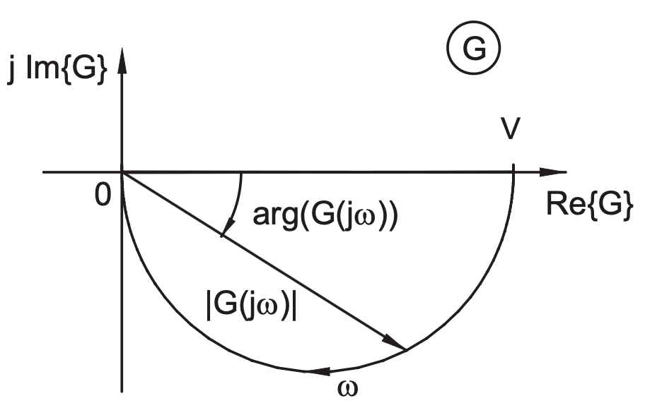

Frequency Response
Response to sinusoidal inputs: $G(jω)$
Amplitude and phase as function of frequency $ω$
Nyquist diagram:

Slide 25
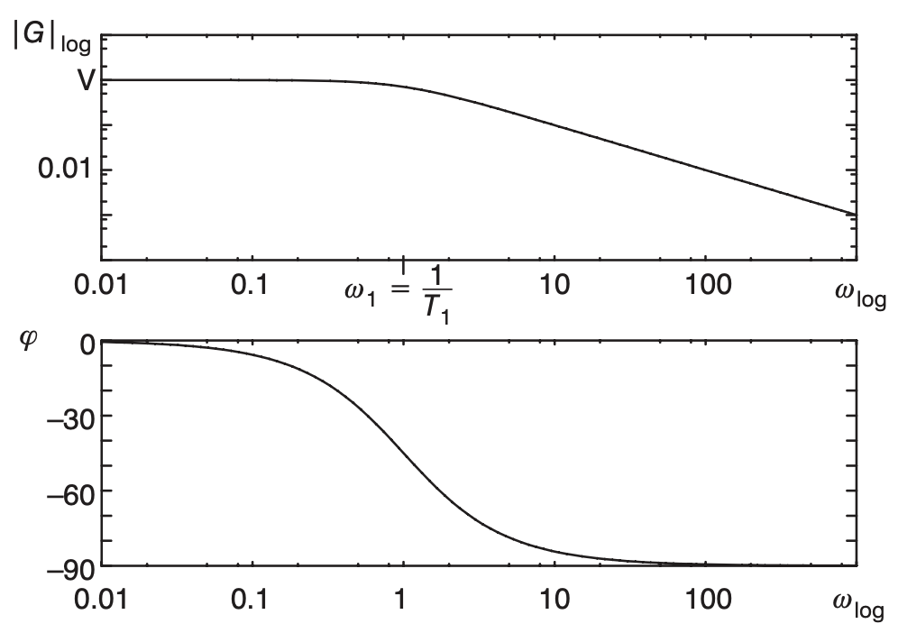
Bode Plots
Magnitude (dB) vs frequency
Phase vs frequency
Logarithmic frequency axis

Slide 26

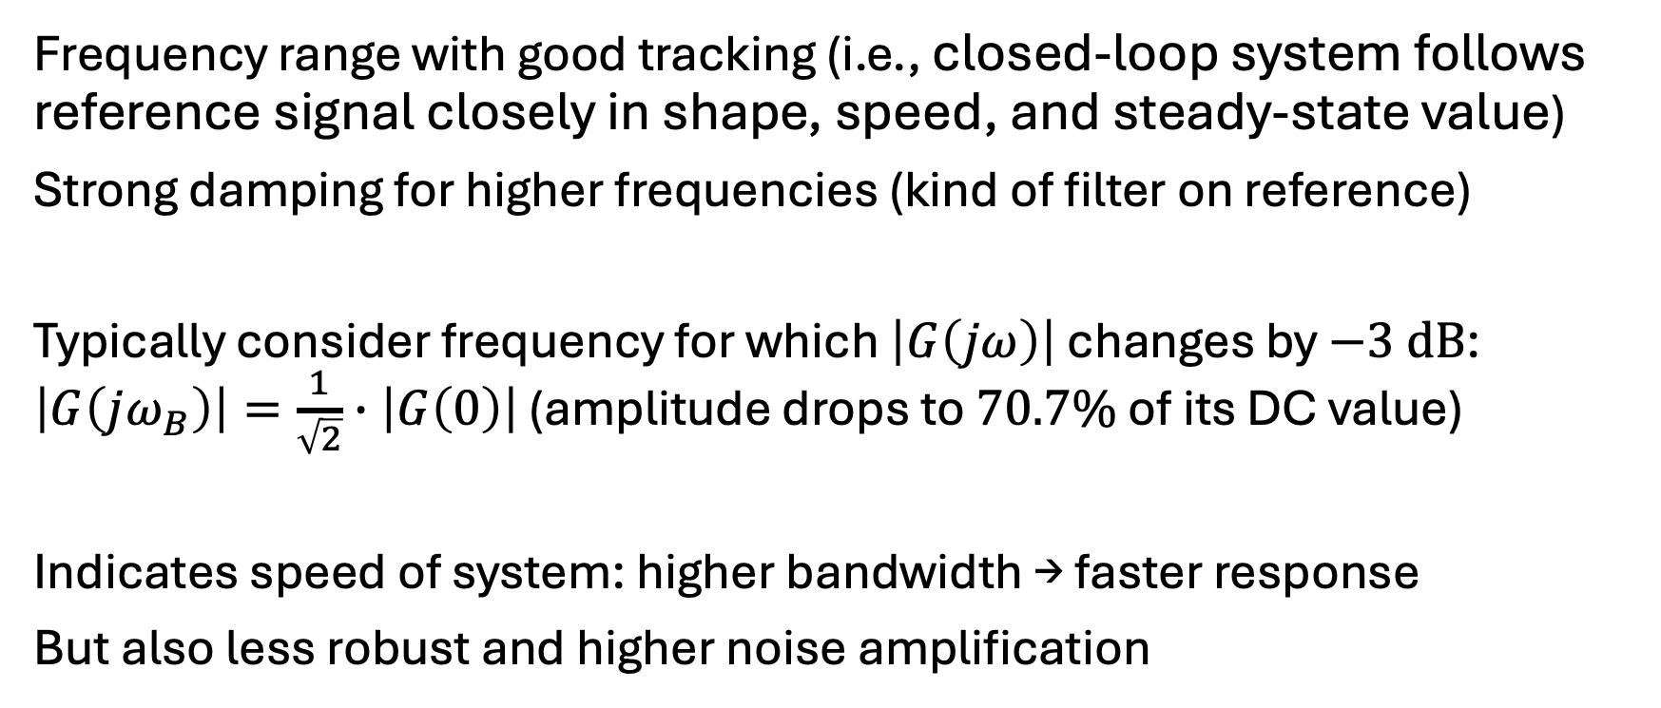
Bandwidth
$$dB=10∙\log_{10}\left(\frac{P_{2}}{P_{1}}\right)$$
For amplitudes ($P\sim A^{2}$):
$$dB=20∙\log_{10}\left(\left|G\left(jω\right)\right|\right)$$
Frequency range with good tracking (i.e., closed-loop system follows reference signal closely in shape, speed, and steady-state value)
Strong damping for higher frequencies (kind of filter on reference)
Typically consider frequency for which $\left|G\left(jω\right)\right|$ changes by $−3 dB$: $\left|G\left(jω_{B}\right)\right|=\frac{1}{\sqrt{2}}∙\left|G\left(0\right)\right|$ (amplitude drops to $70.7\%$ of its DC value)
Indicates speed of system: higher bandwidth → faster response
But also less robust and higher noise amplification

Slide 27
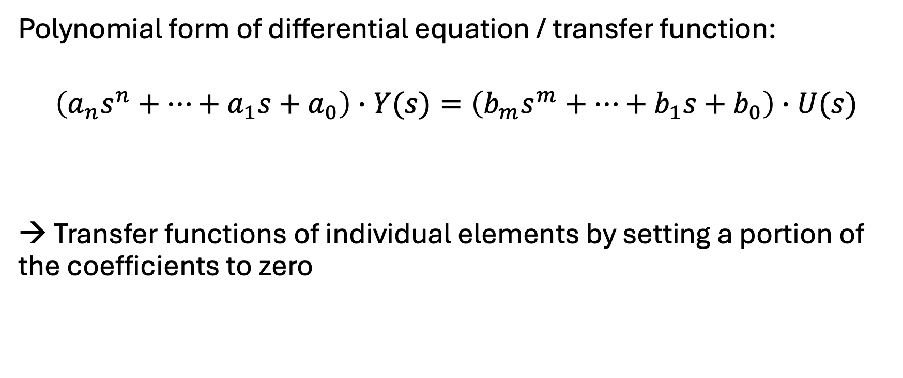
Individual Elements of Control Loops
Polynomial form of differential equation / transfer function:
$$\left(a_{n}s^{n}+⋯+a_{1}s+a_{0}\right)∙Y(s)=\left(b_{m}s^{m}+⋯+b_{1}s+b_{0}\right)∙U(s)$$
→ Transfer functions of individual elements by setting a portion of the coefficients to zero

Slide 28
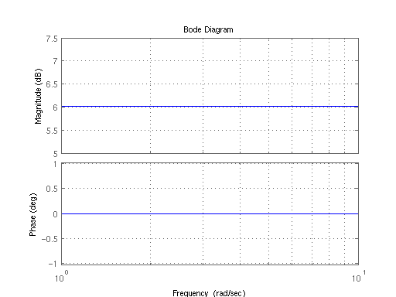
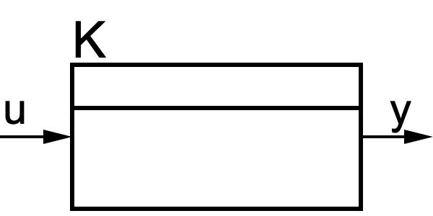
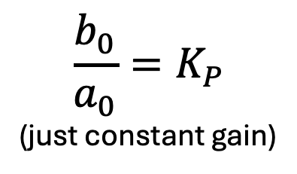

Proportional Element (P)
Consider $n=0$:
$y\left(t\right)=\frac{b_{0}}{a_{0}}∙u(t)$ or $Y\left(s\right)=\frac{b_{0}}{a_{0}}∙U(s)$
$$\frac{b_{0}}{a_{0}}=K_{P}$$
(just constant gain)
Step response:

Slide 29







Integral Element (I)
Pole at $s=0$
Consider $n=1$, with $a_{0}=b_{1}=0$:
$\frac{dy\left(t\right)}{dt}=\frac{b_{0}}{a_{1}}∙u(t)$ or $Y\left(s\right)=\frac{b_{0}}{a_{1}}∙\frac{1}{s}∙U(s)$
$$y(t)=\frac{b_{0}}{a_{1}}∙\int{u\left(t\right) dt}$$
$$\frac{b_{0}}{a_{1}}=K_{I}=1/{T_{I}}$$
(integrator gain or integral time constant)
Energy storage,
memory
Step response:
$$\int{const dt=t}$$

Slide 30








First-Order Lag Element (PT1)
Consider $n=1$, with $b_{1}=0$:
$\frac{a_{1}}{a_{0}}∙\frac{dy\left(t\right)}{dt}+y(t)=\frac{b_{0}}{a_{0}}∙u(t)$ or $Y\left(s\right)∙\left(s∙\frac{a_{1}}{a_{0}}+1\right)=\frac{b_{0}}{a_{0}}∙U(s)$
$$G\left(s\right)=\frac{Y\left(s\right)}{U\left(s\right)}=\frac{K}{T∙s+1}$$
$$T$$
$$K$$
Pole at $s=−\frac{1}{T}$
Step response:

Slide 31

PT1 Signal Flow Diagram
One energy storage

Slide 32




Derivative Element (D)
Amplifies high frequencies, i.e., noise
→ use filtered differentiator (DT1)
Consider $n=1$, with $a_{1}=b_{0}=0$:
$y\left(t\right)=\frac{b_{1}}{a_{0}}∙\frac{du\left(t\right)}{dt}$ or $Y\left(s\right)=\frac{b_{1}}{a_{0}}∙s∙U(s)$
$$\frac{b_{1}}{a_{0}}=K_{D}=T_{D}$$
(differentiator/derivative gain or derivative time constant)
Step response:
physically unrealizable → damping

Slide 33







Filtered Differentiator (DT1)
Consider $n=1$, with $b_{0}=0$:
$\frac{a_{1}}{a_{0}}∙\frac{dy\left(t\right)}{dt}+y(t)=\frac{b_{1}}{a_{0}}∙\frac{du\left(t\right)}{dt}$ or $Y\left(s\right)∙\left(s∙\frac{a_{1}}{a_{0}}+1\right)=\frac{b_{1}}{a_{0}}∙s∙U(s)$
$$T_{1}$$
$$T_{2}$$
$$G\left(s\right)=\frac{T_{2}∙s}{T_{1}∙s+1}$$
$$\lim_{T_{1}→0}{G(s)}=T_{2}∙s$$
→ ideal D element
Step response:

Slide 34


Slide 35

DT1 Signal Flow Diagram

Slide 36







Second-Order Lag Element (PT2)
Consider $n=2$, with $b_{1}=b_{2}=0$:
$\frac{a_{2}}{a_{0}}\frac{d^{2}y(t)}{dt^{2}}+\frac{a_{1}}{a_{0}}\frac{dy\left(t\right)}{dt}+y(t)=\frac{b_{0}}{a_{0}}u(t)$
$Y\left(s\right)∙\left(\frac{a_{2}}{a_{0}}s^{2}+\frac{a_{1}}{a_{0}}s+1\right)=\frac{b_{0}}{a_{0}}∙U(s)$
$$\frac{1}{ω_{0}^{2}}$$
$$\frac{2D}{ω_{0}}$$
$$K$$
Step response:
$$G\left(s\right)=\frac{K}{\frac{1}{ω_{0}^{2}}s^{2}+\frac{2D}{ω_{0}}s+1}$$

Slide 37


Slide 38

PT2 Signal Flow Diagram
Two energy storages

Slide 39





All-Pass Systems
first-order all-pass: $G\left(s\right)=\frac{s−a}{s+a}$
Magnitude constant for all frequencies ($\left|G\left(jω\right)\right|=1$), but phase depends on frequency
coefficients: $b_{k}={\left(−1\right)}^{n−k}a_{n−k}$
→ Zeros are mirror images of the poles with respect to the imaginary axis.
Important in signal processing, e.g., for runtime alignment
second-order all-pass: $G\left(s\right)=\frac{a_{2}s^{2}−a_{1}s+a_{0}}{a_{2}s^{2}+a_{1}s+a_{0}}$

Slide 40


Systems with Dead Time
The transfer function of a system can be extended by multiplying it with the exponential term that represents a time delay:
$G\left(s\right)=G_{0}\left(s\right)∙e^{−{s∙T}_{D}}$
Example: PT1 with dead time
$G\left(s\right)=\frac{K}{1+τ∙s}∙e^{−{s∙T}_{D}}$
Mainly suitable for frequency response analysis (e.g., Bode plots)
Step response (P element with dead time):
original transfer function
time delay (aka dead time)
T_{D}

Slide 41



Bode diagram for system with dead time:
Nyquist diagram for system with dead time:
Nyquist diagram for PT1 with dead time:

Slide 42










Control Loop
$$Y\left(s\right)=G(s)∙\left(R\left(s\right)−Y(s)\right)$$
$$⇒Y\left(s\right)∙\left(1+G(s)\right)=G(s)∙R(s)$$
$$⇒\frac{Y(s)}{R(s)}=\frac{G(s)}{1+G(s)}$$
$$R(s)$$
$$G(s)$$
$$Y(s)$$
$$−$$
closed-loop transfer function for negative feedback
$$R(s)$$
$$C(s)$$
$$P(s)$$
$$Y(s)$$
$$−$$
$$\frac{Y(s)}{R(s)}=\frac{C(s)∙P(s)}{1+C(s)∙P(s)}$$
$G(s)$ above combines controller $C(s)$ and plant $P(s)$

Slide 43

PID Controller Transfer Function
$$C\left(s\right)=K_{p}+\frac{K_{i}}{s}+K_{d}∙s$$
$K_{p}$: increases loop gain → faster response, smaller steady-state error, may increase overshoot
$K_{i}$: adds integrator → eliminates steady-state error, may reduce stability margin
$K_{d}$: adds damping → reduces overshoot, improves transient behavior
Controller design:
Shape the closed-loop poles to obtain the desired dynamics
Achieved by selecting and tuning controller parameters (move the closed-loop poles)

Slide 44
















Hidden Assumptions
$$\frac{Y(s)}{R(s)}=\frac{C(s)∙P(s)}{1+C(s)∙P(s)∙H(s)}$$
$$R(s)$$
$$C(s)$$
$$P(s)$$
$$Y(s)$$
$$−$$
sensor dynamics: If sensor is fast, one can assume unity feedback.
$$H(s)$$
reference prefilter: If reference shaping doesn’t affect stability, one can treat it separately.
actuator dynamics: If actuator bandwidth ≫ closed-loop bandwidth, one can ignore it.
$$R(s)$$
$$F(s)$$
$$C(s)$$
$$A(s)$$
$$P(s)$$
$$Y(s)$$
$$−$$
$$H(s)$$
$$\frac{Y(s)}{R(s)}=\frac{F(s)∙C(s)∙A(s)∙P(s)}{1+C(s)∙A(s)∙P(s)∙H(s)}$$
Always model what can affect poles

Slide 45
Disturbances

